Slide 1
Floating Point Numbers

Slide 2
Floats are not Reals
Int’s:
eg. 40000 * 40000 --> 1600000000
600000* 600000 --> ?
Floats:
Eg 2 : Is (x + y) + z = x + (y + z)?
eg
(1e20 + -1e20) + 3.14 --> 3.14
1e20 + (-1e20 + 3.14) --> ??
Need to understand details of underlying implementations

Slide 3
Objective
To understand the fundamentals of floating-point representation
To know the IEEE-754 Floating Point Standard

Slide 4
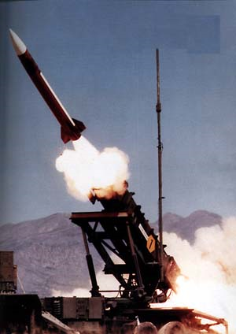
Patriot Missile
Gulf War I
Failed to intercept incoming Iraqi scud missile (Feb 25, 1991)
28 American soldiers killed
GAO Report: GAO/IMTEC-92-26 Patriot Missile Software Problem
http://www.fas.org/spp/starwars/gao/im92026.htm

Slide 5
Patriot Design
Intended to operate only for a few hours
Defend Europe from Soviet aircraft and missile
Four 24-bit registers (1970s design!)
Kept time with integer counter: incremented every 1/10 second
Calculate speed of incoming missile to predict future positions:
velocity = loc₁ – loc₀/(count₁ – count₀) * 0.1
But, cannot represent 0.1 exactly!

Slide 6
Floating Imprecision
24-bits:
0.1 = 1/2⁴ + 1/2⁵ + 1/2⁸ + 1/2⁹
+ 1/2¹² + 1/2¹³ + 1/2¹⁶ + 1/2¹⁷
+ 1/2²⁰ + 1/2²¹
= 209715 / 2097152
Error is 0.2/2097152 = 1/10485760
One hour = 3600 seconds
3600 * 1/10485760 * 10 = 0.0034s
20 hours = 0.0687s
Miss target! (137 meters)

Slide 7
Two weeks before the incident, Army officials received Israeli data indicating some loss in accuracy after the system had been running for 8 consecutive hours. Consequently, Army officials modified the software to improve the system's accuracy. However, the modified software did not reach Dhahran until February 26, 1991--the day after the Scud incident.
GAO Report
http://fas.org/spp/starwars/gao/im92026.htm

Slide 8
Review of Numbers
Computers are made to deal with numbers
What can we represent in N bits?
Unsigned integers:
0 to 2^{N} - 1
Signed Integers (Two’s Complement)
-2^{(N-1)} to 2^{(N-1)} - 1

Slide 9
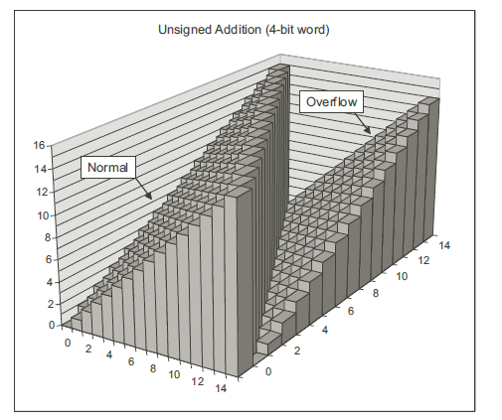
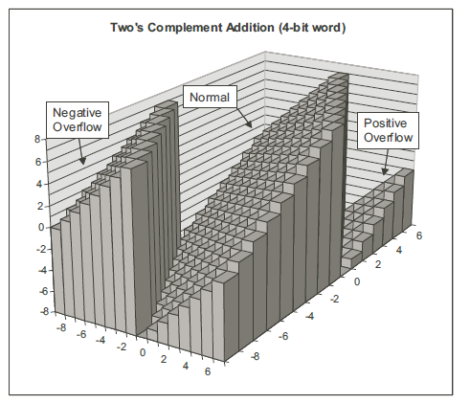

Slide 10
Other Numbers
What about other numbers?
Very large numbers? (seconds/century) 3,155,760,000₁₀ (3.15576₁₀ x 10⁹)
Very small numbers? (atomic diameter) 0.00000001₁₀ (1.0₁₀ x 10⁻⁸)
Rationals (repeating pattern)
2/3 (0.666666666. . .)
Irrationals 2^{1/2} (1.414213562373. . .)
Transcendentals
e (2.718...), π (3.141...)
All represented in scientific notation

Slide 11
Exponential Notation
The following are equivalent representations of 1,234
123,400.0 x 10⁻²
12,340.0 x 10⁻¹
1,234.0 x 10⁰
123.4 x 10¹
12.34 x 10²
1.234 x 10³
0.1234 x 10⁴
The representations differ in that the decimal place – the “point” -- “floats” to the left or right (with the appropriate adjustment in the exponent).

Slide 12
Parts of a Floating Point Number
Exponent
-0.9876 x 10⁻³
Sign of exponent
Sign of mantissa
Location of decimal point
Mantissa
Base

Slide 13

IEEE 754 Standard
Most common standard for representing floating point numbers
Single precision: 32 bits, consisting of...
Sign bit (1 bit)
Exponent (8 bits)
Mantissa (23 bits)
Double precision: 64 bits, consisting of…
Sign bit (1 bit)
Exponent (11 bits)
Mantissa (52 bits)
Prof. Willian Kahan

Slide 14
Single Precision Format
32 bits
Mantissa (23 bits)
Exponent (8 bits)
Sign of mantissa (1 bit)

Slide 15
Normalization
The mantissa is normalized
Has an implied decimal place on left
Has an implied “1” on left of the decimal place
E.g.,
Mantissa →
Represents…
10100000000000000000000
1.101₂ = 1.625₁₀
Normalized form: no leadings 0s (exactly one digit to left of decimal point)
Normalized: 1.0 x 10⁻⁹
Not normalized: 0.1 x 10⁻⁸,10.0 x 10⁻¹⁰

Slide 16
Excess Notation
To include +ve and –ve exponents, “excess” notation is used
Single precision: excess 127
Double precision: excess 1023
The value of the exponent stored is larger than the actual exponent
E.g., excess 127,
Exponent →
Represents…
10000111
135 – 127 = 8

Slide 17
Example
Single precision
0 10000010 11000000000000000000000
1.11₂
130 – 127 = 3
0 = positive mantissa
+1.11₂ x 2³ = 1110.0₂ = 14.0₁₀

Slide 18
Hexadecimal
It is convenient and common to represent the original floating point number in hexadecimal
The preceding example…
0 10000010 11000000000000000000000
4
1
6
0
0
0
0
0

Slide 19
Converting from Floating Point
E.g., What decimal value is represented by the following 32-bit floating point number?
C17B0000₁₆

Slide 20
Step 1
Express in binary and find S, E, and M
C17B0000₁₆ =
1 10000010 11110110000000000000000₂
S
E
M
1 = negative
0 = positive

Slide 21
Step 2
Find “real” exponent, n
n = E – 127
= 10000010₂ – 127
= 130 – 127
= 3

Slide 22
Step 3
Put S, M, and n together to form binary result
(Don’t forget the implied “1.” on the left of the mantissa.)
-1.1111011₂ x 2^{n} =
-1.1111011₂ x 2³ =
-1111.1011₂

Slide 23
Step 4
Express result in decimal
-1111.1011₂
-15
2⁻¹ = 0.5
2⁻³ = 0.125
2⁻⁴ = 0.0625
0.6875
Answer: -15.6875

Slide 24
Converting from Floating Point
E.g., What decimal value is represented by the following 32-bit floating point number?
42808000 ₁₆

Slide 25
Converting to Floating Point
E.g., Express 36.5625₁₀ as a 32-bit floating point number (in hexadecimal)

Slide 26
Step 1
Express original value in binary
36.5625₁₀ =
100100.1001₂

Slide 27
Step 2
Normalize
100100.1001₂ =
1.001001001₂ x 2⁵

Slide 28
Step 3
Determine S, E, and M
+1.001001001₂ x 2⁵
n
E = n + 127
= 5 + 127
= 132
= 10000100₂
S
M
S = 0 (because the value is positive)

Slide 29
Step 4
Put S, E, and M together to form 32-bit binary result
0 10000100 00100100100000000000000₂
S
E
M
+1.001001001₂ x 2⁵

Slide 30
Step 5
Express in hexadecimal
0 10000100 00100100100000000000000₂ =
0100 0010 0001 0010 0100 0000 0000 0000₂ =
4 2 1 2 4 0 0 0₁₆
Answer: 42124000₁₆

Slide 31
Converting to Floating Point
E.g., Express 6.5₁₀ as a 32-bit floating point number (in hexadecimal)

Slide 32
Converting to Floating Point
E.g., Express 0.1 as a 32-bit floating point number (in hexadecimal)

Slide 33
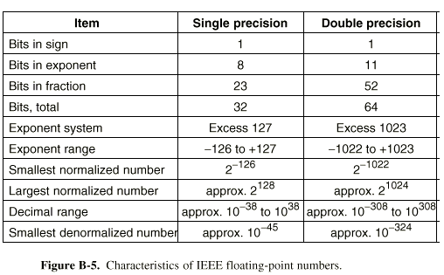

Slide 34
Summary: IEEE Floating Point Single Precision (32 bits)
1
8 bits
23 bits
Sign
Exponent
Fraction
31
30
23
22
0
Exponent values:
0 zeroes
1-254 exp + 127
255 infinities, NaN
Value = (1 – 2*Sign) (1 + Fraction)^{Exponent - 127}

Slide 35
Denormalized Values
Condition
exp = 000…0
Value
Exponent value E = –Bias + 1
Significand value M = 0.xxx…x₂
xxx…x: bits of frac
Cases
exp = 000…0, frac = 000…0
Represents value 0
Note that have distinct values +0 and –0
exp = 000…0, frac ≠ 000…0
Numbers very close to 0.0
Lose precision as get smaller

Slide 36
Special Values
Condition
exp = 111…1
Cases
exp = 111…1, frac = 000…0
Represents value ∞ (infinity)
Operation that overflows
Both positive and negative
E.g., 1.0/0.0 = −1.0/−0.0 = +∞, 1.0/−0.0 = −∞
exp = 111…1, frac ≠ 000…0
Not-a-Number (NaN)
Represents case when no numeric value can be determined
E.g., sqrt(–1), ∞ − ∞

Slide 37
Interesting Numbers
Description exp frac Numeric Value
Zero 00…00 00…00 0.0
Smallest Pos. Denorm. 00…00 00…01 2– ^{{23,52}} X 2– ^{{126,1022}}
Single ≈ 1.4 X 10^{–45}
Double ≈ 4.9 X 10^{–324}
Largest Denormalized 00…00 11…11 (1.0 – ε) X 2– ^{{126,1022}}
Single ≈ 1.18 X 10^{–38}
Double ≈ 2.2 X 10^{–308}
Smallest Pos. Normalized 00…01 00…00 1.0 X 2– ^{{126,1022}}
Just larger than largest denormalized
One 01…11 00…00 1.0
Largest Normalized 11…10 11…11 (2.0 – ε) X 2^{{127,1023}}
Single ≈ 3.4 X 10³⁸
Double ≈ 1.8 X 10³⁰⁸

